Slide 1
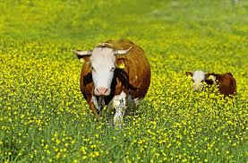
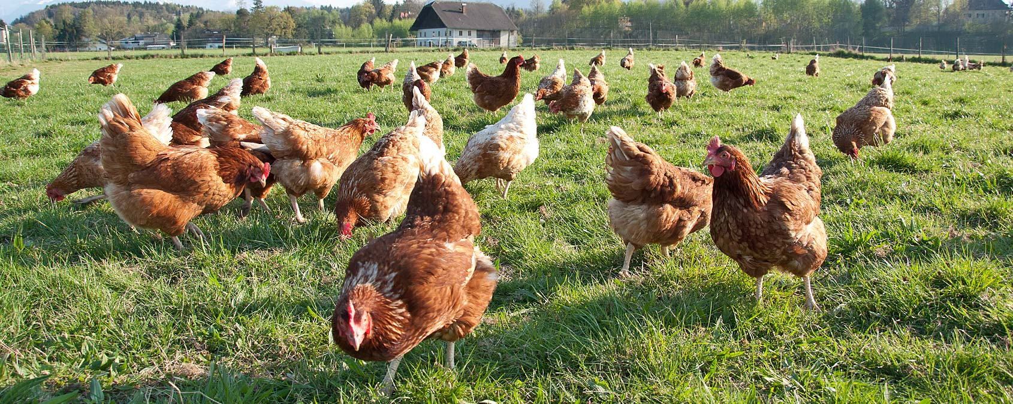
Nontraditional jobs Biological Farmer/Organic Farmer
Sophie Schuch

Slide 2
What are they doing?
Work with composting
Work with Pesticides
Work with rotted vegetables, fruits and branches

Slide 3
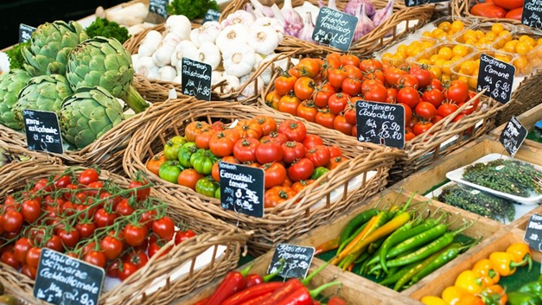
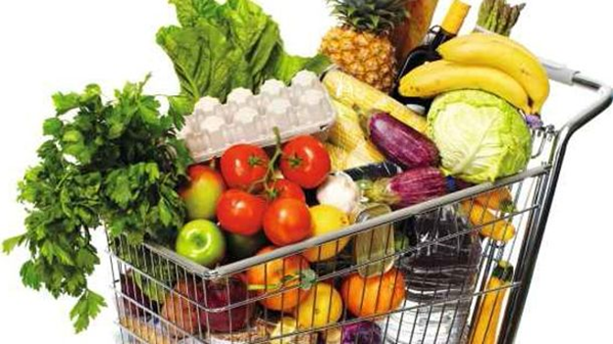
Biological- organic Farmer
Little stores
Biological products: milk, eggs, vegetables and fruits
Ony biologicalproducts

Slide 4
How do you become a biologicalfarmer?
First: study argiculture
Second: basic education
third: further education as a Professional/bio-dynamic argiculture

