Slide 1
Pursemaker (kaletnik)
Julia Grochowina, Hania Nawrocka, Amelia Janiak

Slide 2
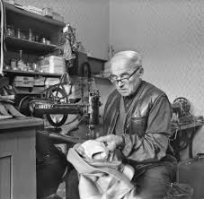
Basic information
Pursemaker manufactures, maintains and repairs items made of natural leather, artificial leather or textiles, such as belts, handbags, travel bags, wallets etc.
This profession was created in XIV century.
A person trained in this field may seek employment in one of the cassette studios or open his own business.
The earnings of the pursemaker strictly depend on character of his business and the number of orders he receives.

Slide 3
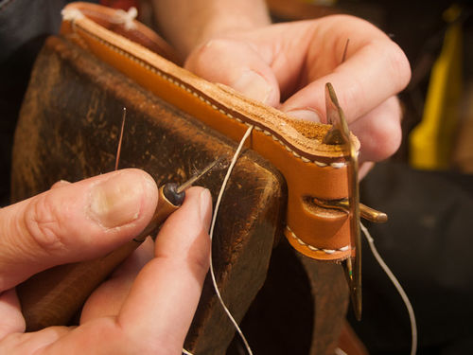
What he does?
The work of the pursemaker starts with the analysis of the project and transfering it into a technical sketch, then on template made of cardboard or plastic. The next step is to cut the pattern from skin or other material based on the previously prepared template. The pieces obtained this way are joined together by narrowing their former edges or extruding patterns previously fixed in the design. All stages of the work of the pursemaker are realized with the use of specialized machines and equipment.

Slide 4
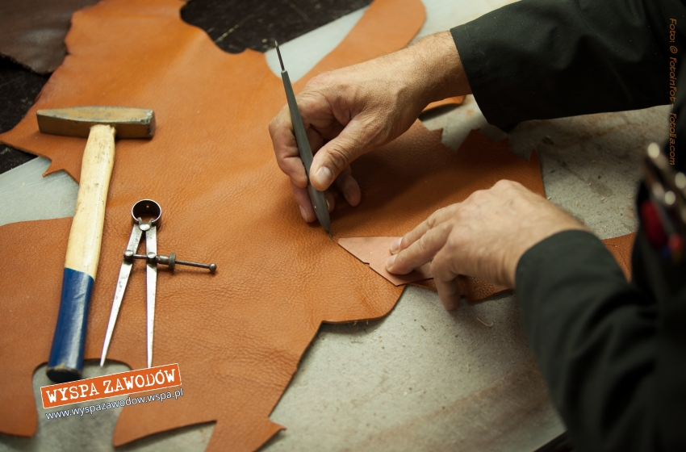
Requirements
The first and most important factor in the path to pursue a career as a pursemaker is the completion of one of the most important schools or technicians who educate pursemakers. Effective carrying out of the duties of a pursemaker is only possible if you possess superior manual skills and personal qualities such as diligence or patience. Knowledge of machinery and equipment used on site is also important.

Slide 5
Sources: http://www.praca.pl/poradniki/lista-stanowisk/przemysl-produkcja/kaletnik_pr-988.html https://pl.wikipedia.org/wiki/Kaletnik Google images http://kaletnik.info/kaletnictwo-jak-to-sie-zaczelo

