Slide 1
Traditional and non traditional jobs
ITALIAN TEAM

Slide 2
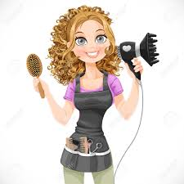
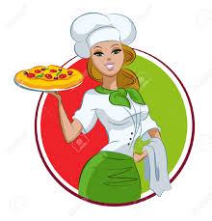
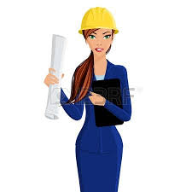
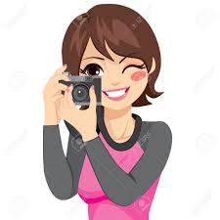
The Italian Team
Giorgia
Dafne
Federico
Vincenzo
Matilde
Mariachiara

Slide 3
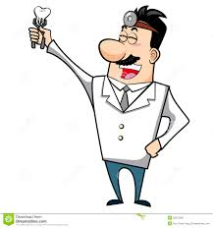
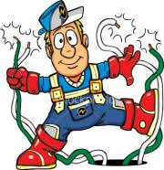
Traditional jobs
Dentist
Electrician

Slide 4
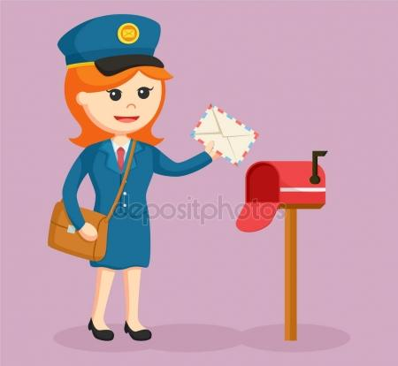
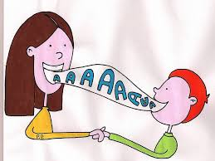
NON Traditional jobs
Post woman
Speech Therapist

Slide 5
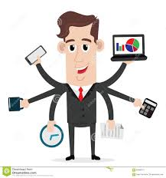
DENTIST
1
QUALIFICATION : Bachelor of Dental Health Degree
SKILLS: Good Scientific knowledge
Ability to relate
Ability to work in team
Stay calm under pressure
SALARY: 60,000 to 140,000 €

Slide 6
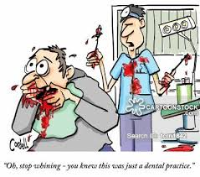
Responsibilities
Working Condition

Slide 7
ELECTRICIAN
2
QUALIFICATION : Professional school for electrician
SKILLS: Follow instructions
Methodical approach to work
Problem solving abilities
Interpersonal skills
SALARY: 10,000 to 50,000 €

Slide 8
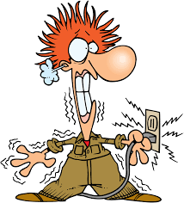
Responsibilities
Working Condition

Slide 9
POSTWOMAN
3
QUALIFICATION : No formal qualification
SKILLS: Friendly and approachable
Self-motivated but also good in team
Competent literacy skills
SALARY: 800 to 1,200 €

Slide 10
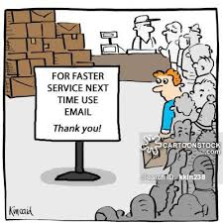
Responsibilities
Working Condition

Slide 11
SPEECH THERAPIST
4
QUALIFICATION : 3/5 years Degree
SKILLS:Excellent communication and listening patience
Problem solving
Work in team
Flexibility
Empathy
SALARY: 30,000 to 40,000 €

Slide 12
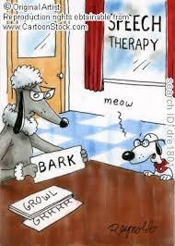
Responsibilities
Working Condition

Slide 13
Unemployement
22.1%
61.4%
NEET
40%
22.1%

Slide 14
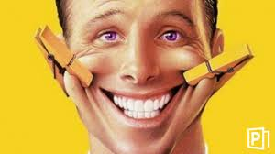
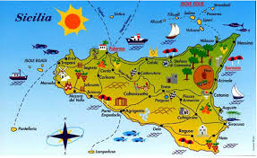
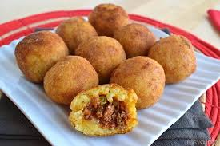
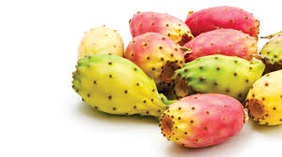
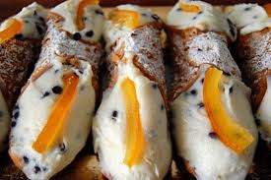
ARANCINI MAKER
PRICKLY PEAR FARMER
CANNOLI TASTER

Slide 15
THANKS FOR YOUR ATTENTION

